Slide 1
Open Sesame Proposal Presentation
Denise Garcia
Ka Hin Lee
Veronica Martinez
Jane McGuinness
Angela Savela

Slide 2
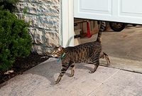
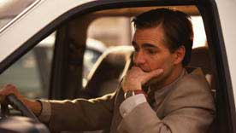
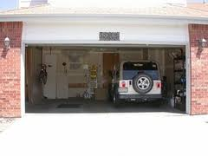
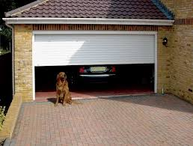
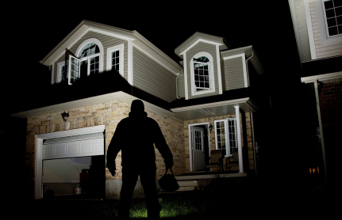
http://www.drivers.com/article/680/
http://www.geniecompany.com/support_safety.aspx
http://www.cozypad.com
http://www.ponderosagaragedoors.com/how-to-prevent-home-invasions-through-your-garage-door/garage-door-theft-prevention/

Slide 3
Problem Description
Accidently open garage doors lead to:
Trespassing
Burglary
Lost Pets
Unknown status of garage door
No confirmation from garage door
Lack of control from long distance

Slide 4
Proposed Solution
Sensor network
Automatic, hands-free open/close
Smartphone access
Send/receive message
Receive image
Security features
Status updates
Safety features
Unexpected obstructions

Slide 5
Demonstrated Features
Safety System
Automatic Car-Activated Door Open/Close
Remote Visual of Door
Remote Phone Controlled Open/Close
Classic Button Panel and Remote
Fail-Safe Systems
Battery

Slide 6
System Overview
Garage Opening Motor
Garage Overhead Light
Garage Opener System
Car Motion Sensor
Remote Controls
Central Circuit Board/Hub
Button Panel
Door Safety Sensor
Camera
User Cell Phone
Legend:
Wireless Connection
Wired Connection
Garage Opener Subsystem

Slide 7
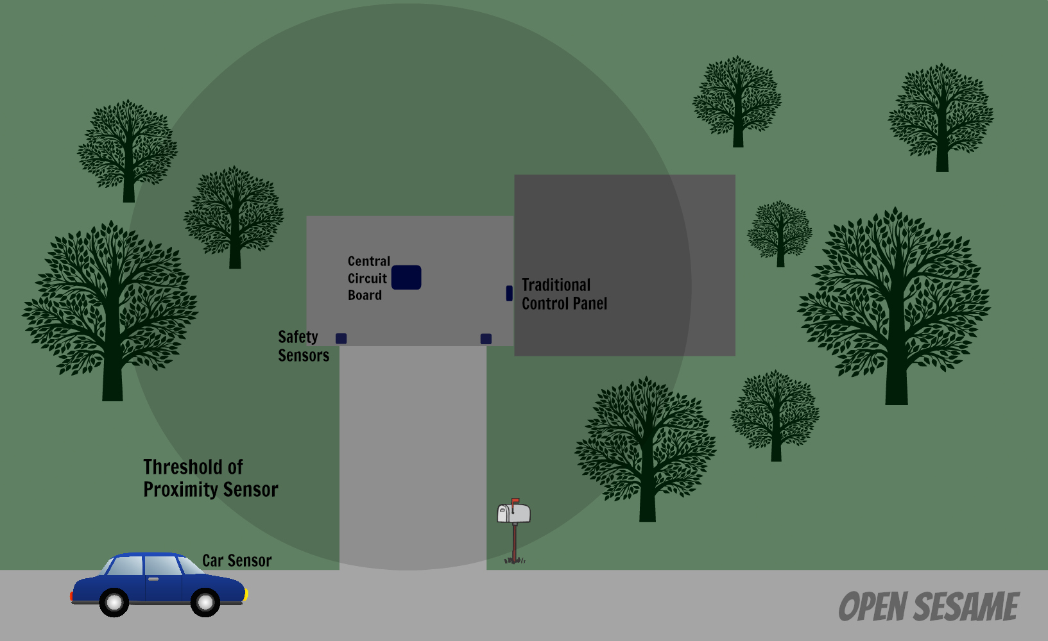
System Set Up

Slide 8
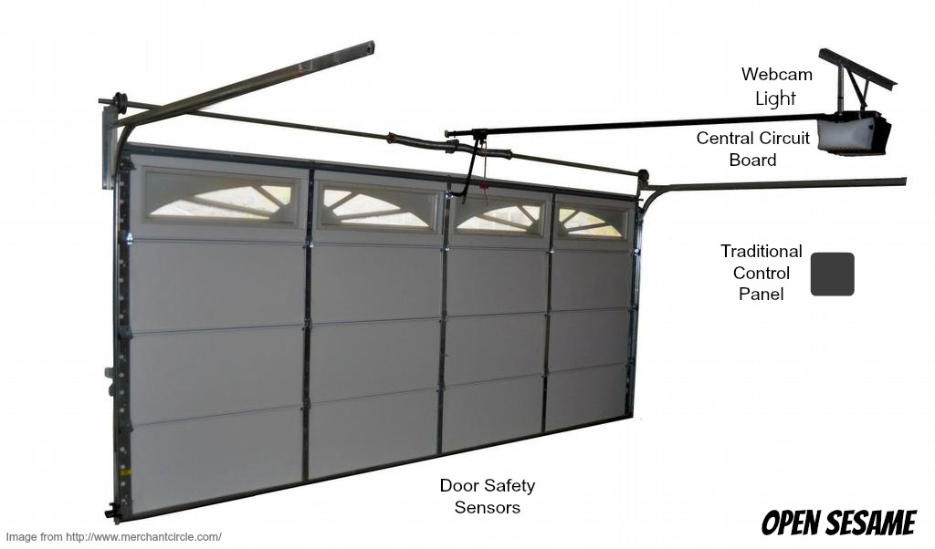
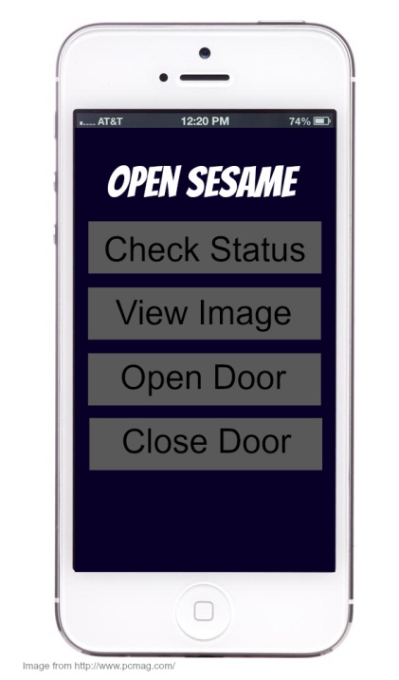

Slide 9
Available Technologies
Part | Use | Estimated Cost
Ultrasonic Range Finder | To detect objects in the line of view of the garage door | $40
Infrared Proximity Sensor | To detect car approaching or leaving the driveway | $20
Webcam | To take images of the garage door | $30
Surveillance Camera | To take images of the garage door | $20
AA Lithium Batteries | To power the sensors, camera, remote control | $4/battery
Garage Door Opener | To open/close garage door; includes motor with chain system, 2 remote controls, light | $150

Slide 10
Engineering Content
Interface with garage door opener
Cell phone communications
Sensor usage
Wireless communications
Core program
Power supply and batteries
Demonstration of functionality

Slide 11
Any Questions?

